Slide 1


Announcements
ASEN 3728 Aircraft Dynamics
UNIVERSITY OF COLORADO BOULDER

Slide 2
Exam 1
Please leave an empty seat between you and your classmates
Please do not open the exam yet;
There are 4 questions. You will write all your answers on the answer sheet.
At 1:00, you will sign the exam. You will start at 1:01
Exam will end at 2:16
Good Luck!
Turn in: Questions in LEFT box | Answer sheet on RIGHT box
Keep your equation sheet

Slide 3
Announcements Feb 20
P2 due Friday, (late due date Sunday)
Need control systems toolbox for ss, initial, evaluate with wind
If you have trouble with this, can use ODE45
Exam 1 next Tuesday
Exam Review Monday at 6pm (location announced on Canvas)

Slide 4
Announcements Feb 17
W2, P1 grades released on gradescope
P2 due Friday, (late due date Sunday)
Exam 1 next week (more on this mid-class)

Slide 5
Announcements Feb 13
If you received an email from Kelvin about P1, please respond by 11:59 pm tonight (you will lose credit if you do not)
W3 Due tonight
P2 Released, due Friday 2/21, but late due date is still 2/23
Part 1 Notes released in Materials -> lecture notes
W2 Solutions Released

Slide 6
Announcements Feb 11
HW W3 Due Thursday
HW P2 Released Soon

Slide 7
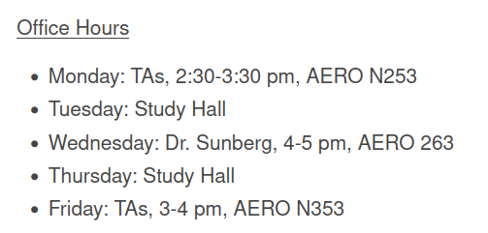
Announcements Feb 6th, 2025
Homework W2 – due Today
Homework W3
Additional Office Hours on Canvas (start next week)

Slide 8
Announcements Feb 4th, 2025
Homework W1 grades released (regrades until 2/18). Solutions in Files -> Solutions
Homework W2 – due Thursday
Homework P1 Leaderboard
Additional Office Hours TBA Soon

Slide 9
Announcements Jan 30, 2025
New Exam Dates on the Schedule
Wiki linked to on canvas
Homework W1 is 97% graded
Homework P1 due midnight tonight
Homework W2 released – due next Thursday
Study Hall tonight (T/Th 5:30-7pm) N240

Slide 10
Announcements Jan 21, 2025
Follow the link in the announcement to join the slack
Homework W1 due Thursday Saturday
Office Hours: 4-5 pm Wednesday (also this Friday only 1-1:30 pm)
Study Hall tonight (T/Th 5:30-7pm) N240

Slide 11
Announcements Jan 16, 2025
Discussions: Slack!
Reminder: Homework W1 due next Thursday
I-Clicker Quizzes start today (today’s will not count for a grade; scoring will start Tuesday)
Office Hours: 1 PM Friday starting NEXT WEEK

